Slide 1
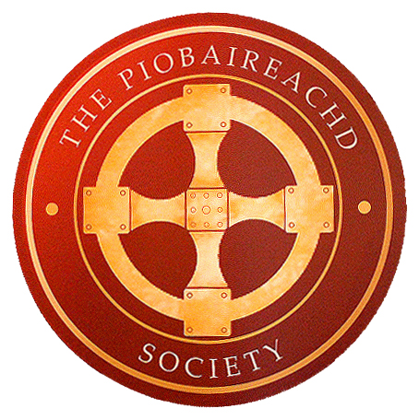
The Composition of Piobaireachd
Peter McCalister, John Dew, and Dan Nevans

Slide 2
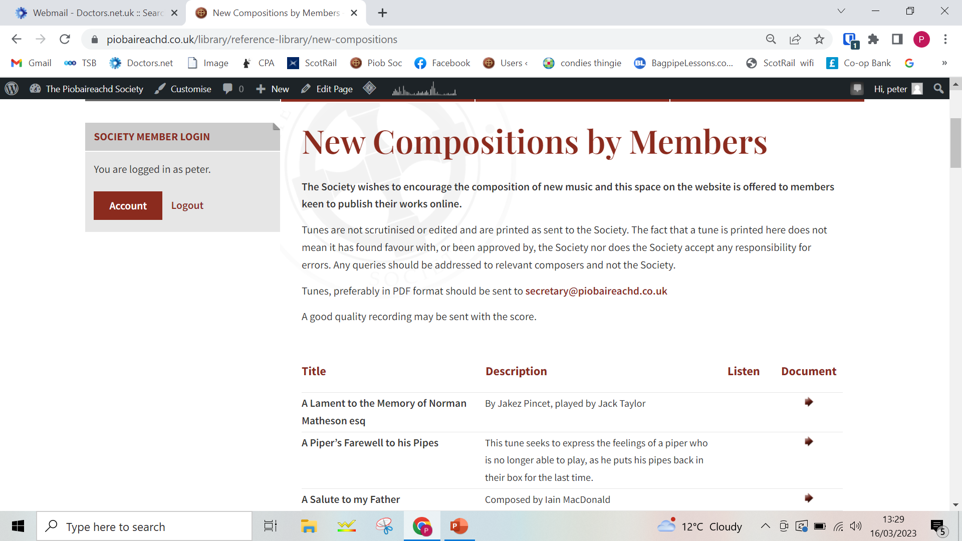
Modern Piobaireachd on the Piob Soc website

Slide 3
Could these be Set Tunes or form the basis of a new Piob Soc Collection volume?
Malcolm MacRae laid out some guidelines as to what we could use to assess such tunes, should we wish to do so
But some are less “good quality” than others
Some are slow airs in piobaireachd mode
Some lack a connection between Ground and Variations
Many are hard to memorise
And then there’s the “Blas” …

Slide 4
Methods of Piobaireachd Composition
Piobaireachd composition Origin
Development
Where we are today

Slide 5
Evolution of music harmony
Tension and release
Modern day compositions and methods
Questions

Slide 6
About me
Professional musician and composer with nearly 10 years of experience
Graduate of the Royal Conservatoire of Scotland Bmus traditional music degree
3 Film scores – one of which won 3x Royal Television Society Awards
Winner of the Agnes Miller Harmony and Counterpoint Prize for Advanced Compositional techniques
2nd in the MacGregor Memorial 2015
B grade piobaireachd wins at Captain John MacLellan and Inveraray Highland Games, 2019 Duncan Johnstone Champion as well as places in The Silver Medal
Winner of the 2019 Royal National Mod – 1st in Piobaireachd

Slide 7
Evolution of music harmony
Plainchant and organum
Plainsong and drone
2-5 part counterpoint/ species counterpoint
Fugues
19th Centaury harmony
Where does piobaireachd lie

Slide 8

Plainchant – Cantus planus
Simply a single line of Melody
Developed during the earliest centuries of Christianity

Slide 9
Organum
A single line evolved into organum, around 900AD.
Organum = additional voices to the single line
First the drone
Then the moving drone – 2nd species counterpoint = 2 notes against 1 note

Slide 10
Later evolving into other species counterpoints
Third Species = 4 notes against 1 note
Fourth Species = delayed resolution

Slide 11
Fifth species - polyphony
Polyphony – Palestrina Mass

Slide 12
More complex polyphony
Preludes and Fugues
Primary Chord Structures
19th Century Harmony
Bi-Tonality
20th century harmony – 12 tone row
Minimalism
Quarter-tones and micro-tones

Slide 13
Why is this important?
They all demonstrate different ways of exploring tension and release through harmony

Slide 14
Where does piobaireachd lie, and why?
Piobaireachd takes the form chant and drone – using ecclesial church modes coinciding with our Christian Society
Why?
My guess is working-class agrarian demographic of the Highlands and Islands of the Middle Ages.
We use the drone to form our harmonic tensions and releases

Slide 16
The Ecclesial modes or Church Modes
Pentatonic
Ionian Mode
Dorian Mode
Phrygian Mode
Lydian Mode
Mixolydian Mode
Aeolian Mode
Locrian Mode

Slide 17
Piobaireachd structures and variations – Forms
Ground
Variations:
Suibhal
Dithis
Irregular
Taorluath
Cruanluath
A-Mach

Slide 18
Piobaireachd structures and variations – design and measures: Harmonic symmetry
3) Woven:
A A B A
B B A B
MacCrimmon’s Sweetheart
4) Well-Woven:
ab A B A
ba B A B
The Battle of Strome
The Big Spree
1) Rounded:
A1A2A1 A2
B1 B2 B1 A2
The Prince’s Salute and Lament for Mary MacLeod
2) Interlaced:
A B A B-Flavour Cadence
B A B A-Flavour Cadence (4x Hiharin)
The Lament for the Dead

Slide 19
Tension and release – harmonic tunes and melodic/lyrical tunes
Lyrical tunes examples:
Lament for Donald Doughall MacKay
Corrienessan’s Salute
The Earl of Seaforth’s Salute
Scarce of Fishing
Lament for Donald Ban MacCrimmon
Lament for the Children
Massacre of Glencoe
They all use passing notes and don’t follow a strict use of strong pulses as harmonic markers

Slide 20
Tension and release – harmonic tunes and melodic/lyrical tunes
Harmonic tunes examples:
Bells of Perth
Weighing from Land
The Battle of Strome
The Blind Piper’s Obstinacy
Tulloch Ard
Welcome Johnny Back Again
The Battle of Auldearn (1 and 2)
They all use limited passing notes and follow strong harmonic markers

Slide 21
‘A piper’s farewell to his pipe’ by Steven Knox
“This tune seeks to express the feelings of a piper who is no longer able to play, as he puts his pipes back in their box for the last time.”
Pros
Scored in phrases rather than in bars
Theme notes follow ground nicely

Slide 22
A piper’s farewell to his pipe - cons
Uninventive variations, this could be explored more
Takes the simplest of structures – rounded
Quasi-rounded form because the last bar in line 2 doesn’t match the last bar in lines 1+3
Feels a little too hybrid of Lament for MacLeod of MacLeod, Lament for MacSwan of Roaig and MacDougall’s Gathering
Full of “usual suspects” of piobaireachd movements which has been explored in tunes like The Big Nameless or Ronald MacDonald of Morar’s Lament
There doesn’t seem to be an identifiable “hook” which defines this piece. Think about how MacCrimmon’s Sweetheart is instantly identifiable
There feels like there are extra pulses that are a little random

Slide 23
How could this piece be improved?
Ground:
Final phrase, feels like an extra pulse
Perhaps it would be better not to resolve the phrase: Stay on the Low G. This tension between low G and drone gives discomfort which further exemplifies the “feelings of a piper who is no longer able to play”.
Alternatively you could do this:
But that could be too similar to Isabel MacKay

Slide 24
How could this piece be improved?
This final phrase should also be consistent in each line, it changes in line 2
Immediately you lose the sense of unison AND symmetry by introducing a new melodic line

Slide 25
How could this piece be improved?
Variations:
It follows a simple Dithis, Taorluath, Cruanluath singling and doubling.
This has been done to death: Lament for Colin Roy MacKenzie, The Kiss of the King’s Hand etc
Take us on a journey following the theme notes
Then, develop

Slide 26
How could this piece be improved?
Variations:
Take us on a journey following the theme notes
Why not pass it through 6/8?

Slide 27
Why new compositions are poor – in a nutshell
They sound too similar to other tunes or a hybrid of several tunes e.g. Salute to Ronald Alexander MacDonald
They are very “slow air” like and are often too lyrical e.g. Lament for Sir Tommy Macpherson
Follow theme notes too rigidly e.g. Farewell to the Reedmaker
Big big memory tests e.g. Salute to the Isle of Iona
They follow only the simplest of structures (rounded form) and don’t explore more complex structures – very few take the well-woven structure
Lack originality in variations e.g. ground – dithis – taor – cruan e.g. The Garden of Roses
Do not have a desirable “hook” that give it its USP e.g. The Earl of Seaforth’s Salute
Rarely have satisfactory tensions and releases e.g. Roderick MacLeod’s Lament
For me, the main missing element is the lack of harmonic symmetry

Slide 28
Why new compositions are poor – a more in-depth reason..
We’re too used to composing by arithmetic standard notation
For example:
Something sounds good but we’ve not used the final 4th pulse according so lets add on an extra D throw to make it fit in the 4/4 score we’ve created
Rather than composing in structural phrases
We’re used to composing by sight of paper rather than by sound
For example:
We’re used to reading and if we read ahead we know the direction of the melody.
If we put the music away and listen we’ll often find that the melody should go in an alternative direction..

Slide 29
Why new compositions are poor – poorly scored, hard to interpret
E.g. Rubh an Dunain line 2 penultimate 2-bar-phrase
Better scored like this, easier to interpret

Slide 30
The main problems we face today
With the exception of Andrew Wright’s ‘General Principals of Piobaireachd’, Piobaireachd “theory” (for what of a better word) is not being taught
Often expression is poorly explained by experts
Tunes are being taught as single entities rather than as a transferrable templates
“I couldn’t tell you if they played The Battle of Sherrifmuir well because I don’t know the tune..”
Teachers are closed minded about interpretation resulting in a lack of possible ideas explored across the genre.
This leads to poor piobaireachd composition due to lack of knowledge

Slide 31
Suggestion of methods of composition
Compose in musical phrases and make rough sketches rather than trying to mould something into a 3/4 or 4/4 pulsation
Why start with the ground?
Start with the taorluath doubling and try and create a nice melody from that variation
Start with a lyrical variation doubling and construct your ground based on that
Think of the essence of the composition and encapsulate a sensation e.g. The Bells of Perth is about the ringing of Bells. Come up with a more obvious musical entity such as The Edinburgh Tram Ways or Grandpa Simon’s Snoring to inspire a rhythmic variation..
Be a little more savvy with your musical intentions e.g. Lament for Alan my Son
Make it clear in the score – the idea that we can’t portray expression in a score is ludicrous!
Demonstrate that you know the basics by writing a simple tune in a standard form and then build on that.
Study study study

Slide 32
Study Study Study
Understand:
Piobaireachd structures e.g.
4-6-5 line structures (Woven)- Lachlan MacNeil Campbell of Kintarbert’s Fancy and The Earl of Ross’s March
Harmonic structures and symmetry e.g.
The harmonic symmetry of The Big Spree
Functions of church modes e.g.
Raised 6th in the E dorian Mode e.g. The big C# in The Bicker
But why is that mode that mode..

Slide 33
Lastly.. “the musical expression of the music cannot be shown in the musical score”
This statement is ludicrous
Why?
Because a score can show relativity and expression is determined by the performer and is suggested in the score
For example:

Slide 34
Demonstrate that you understand basic forms and structures of piobaireachd by writing a tune using the simpler structures
Then develop that understanding with newer pieces
Create a simple piece first before you write the next “kings taxes”

Slide 35
How would you, the members of the society, like to see/hear improvements in piobaireachd composition?
For me, it’s teaching these principles:
1) how the music works aurally
2) How it is portrayed in a musical score
3) How to then interoperate scores and transfer the skills
Provide a skill base and proper understanding of functions and principles of piobaireachd

Slide 36
Bibliography
COLLINSON, Francis ‘The Traditional and National Music of Scotland’ Routledge and Kegan Paul (LONDON)
Practical Musicianship classes at The royal conservatoire of scotland. Lecturer: HAMISH NAPIER
Piobaireachd society scores and websites
FLANDREUO, Tara. Online ‘Music Theory Teacher’ accessed 21/01/2020 - http://www.musictheoryteacher.com/pb/wp_2e247577/wp_2e247577.html
FUX, Johan Joseph. ‘The Study of Counterpoint’ (revised edition) translated and edited by Alfred Mann. W. W. Norton and Company, Inc. Published 1965
LOVELOCK, William. (D.Mus London) ‘First Year Harmony’ a Hammond Textbook. William Elkin Music Services (First published 1939)
Piobaireachd society website accessed 15/03/2023 wright, Andrew ‘general principles of piobaireachd, the college of piping 2013
STURMAN, Paul. ‘Advanced Melody Harmony Composition’Longman Group 1986
TCHAIKOVSKY, Piotr Ilyitch. ‘Guide to the Practical Study of Harmony’ Dover Publications Inc. (Dover Edition) published in 2005

Slide 37
There will be no questions…

Slide 38
Conclusion – can composition be taught?
History of composition would suggest “yes” – Mozart, Beethoven, Stravinsky, the list is endless. Few composers are self-taught.
Should we encourage the teaching of piobaireachd composition or continue to allow it to proceed with no guidance whatsoever?
Should the Piob Soc take a role in this process?
Any Questions?

